Slide 1

Maverik Revenue Forecast
Presented by:
Pablo Zarate
Roman Brock
Biva Sherchan
Bhoomika John Pedley

Slide 2
Project Objective
Build a predictive model that Maverik can use to predict sales upon opening a new store.
Sales KPIs are as follows:
Inside Sales (Merchandise)
Food Sales
Diesel Sales
Unleaded Sales
Project Scope
Build a time-series model to predict sales across 4 different KPIs
The model(s) must be rolling (able to ingest actuals to revise forecasts)

Slide 3
Business Problems & Risks
Four separate predictions are needed
Limited knowledge of specific domain / industry
Forecast must be rolling
Rolling forecast models are computationally demanding
Variations in seasonality + sales volume across stores

Slide 4
Results
Six-Month RMSE Comparison
 | Our Model | Benchmarks*
Inside Sales (Merch) | 1065.6 | 3283.1
Food Sales | 390.2 | 1081.7
Diesel Sales | 1119.0 | 4398.0
Unleaded Sales | 892.7 | 5845.4
Maverik would have experienced an average 73% reduction in prediction error for store ID 24535, based on these assumptions.
Inside Sales: 67.5%
Food Sales: 63.9%
Diesel Sales: 74.6%
Unleaded Sales: 84.7%
*Average RMSE score from 37 stores
Notes:
We have developed a rolling forecast model using Prophet that produces daily sales predictions for a new store

Slide 5
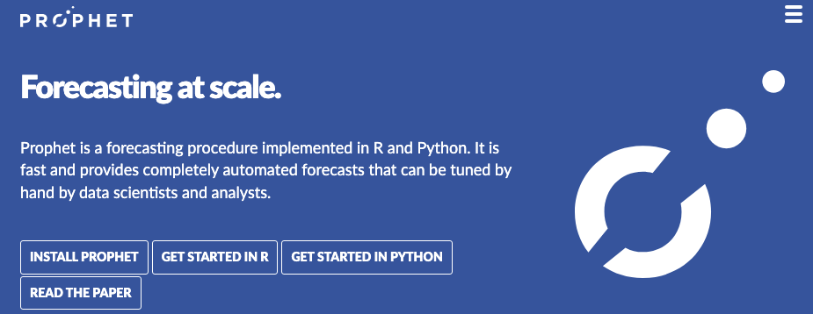
Prophet Model
What is Prophet?
Open-source forecasting tool designed to work with time series data.
Effective for datasets with strong seasonal effects and extensive historical data.
Processing Time & Computational Requirements
Computational Resources: The model was run on a 16GB Mac laptop
Processing Time: 1240 minutes (20 hours and 40 minutes)
With higher CPU & RAM, we could run this model for all stores.
Notes:
Developed by Facebook, Prophet is an open-source forecasting tool tailored for business time series data. It's designed to handle the common features of business forecasting, such as seasonality, holidays, and weekends.
It's particularly effective for datasets that have strong seasonal effects and several seasons of historical data.
Unlike more complex models, Prophet is easier to use and understand. It requires fewer manual interventions, making it ideal for our rolling forecast model.
Advantages
Robust to Shifts in Trend: Prophet can handle changes in trend, making it well-suited for real-world, fluctuating data. In the data provided, sales fluctuated due to various factors. Prophet's robustness makes it a useful tool for such scenarios.
Handles Seasonality with Ease: We leveraged Prophet's ability to model multiple seasonality patterns - day of week, seasons and yearly, which was crucial for predicting sales accurately.
Incorporates Special Events: Prophet allows the integration of special events. For Maverik, this meant incorporating the list of national holidays that significantly impact sales.
Our Model
Custom Seasonality and Holidays: We tailored the model to Maverik's specific business cycles, incorporating custom ‘season’ seasonal patterns, ‘day of the week’ and significant holidays patterns
Rolling Forecast: Our model is produced to update forecasts daily, incorporating the most recent sales data. This approach keeps the forecasts aligned with the latest trends and patterns.

Slide 6



Model Benefits
Strengthens prediction accuracy
Improves supply chain management
More accurate initial ROI estimates
Notes:
A 73%

Slide 7
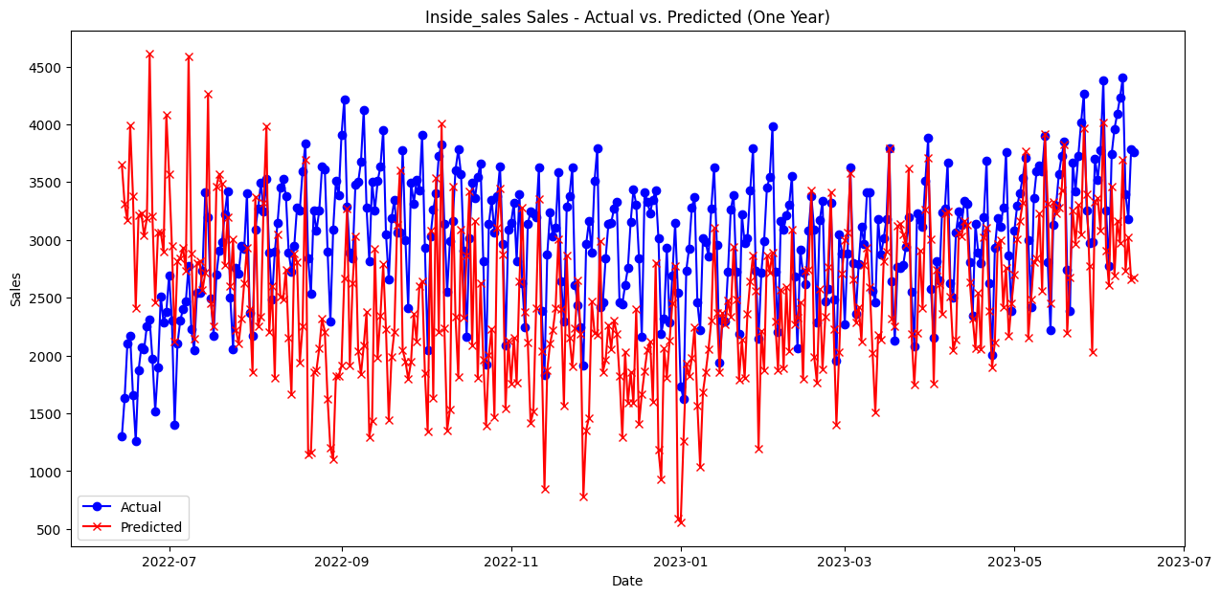
Model Performance: Actuals vs Predictions
Inside Sales (Merch) Results
two_week - RMSE: 1447.6, MAPE: 75.9
three_week - RMSE: 1300.3, MAPE: 63.9
six_month - RMSE: 1065.6, MAPE: 32.6
one_year - RMSE: 907.6, MAPE: 25.8
Notes:
What you’ll see in each chart is that every sales metric’s RMSE and MAPE gradually decrease over time as the model takes in new daily sales data
RMSE vs MAPE: Using both metrics is important when assessing model performance.
RMSE looks at model fit to actual sales, and produces score based on the magnitude of error produced
MAPE is the absolute percentage error of the actuals and predicted value

Slide 8
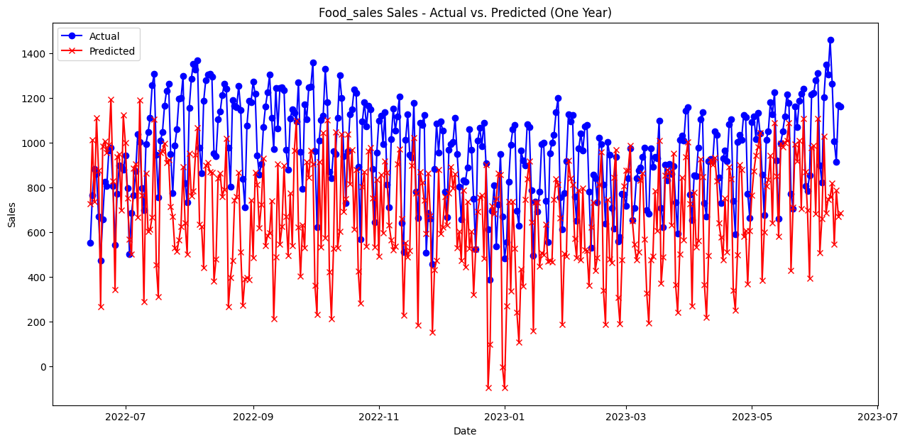
Model Performance: Actuals vs Predictions
Food Sales Results
two_week - RMSE: 190.5, MAPE: 24.5
three_week - RMSE: 178.2, MAPE: 22.0
six_month - RMSE: 390.2, MAPE: 32.5
one_year - RMSE: 360.2, MAPE: 31.8

Slide 9
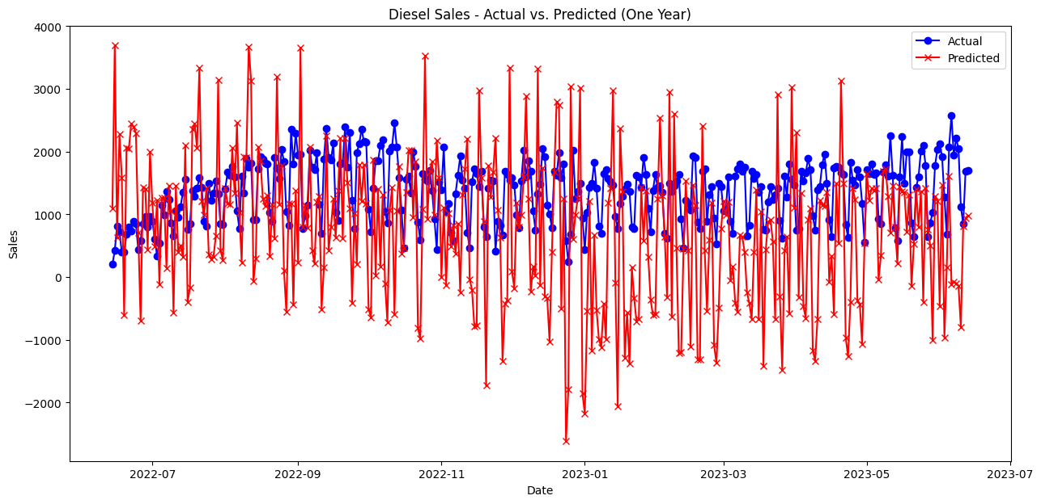
Model Performance: Actuals vs Predictions
Diesel Sales Results
two_week - RMSE: 1399.3, MAPE: 222.1
three_week - RMSE: 1203.8, MAPE: 178.4
six_month - RMSE: 1119.0, MAPE: 83.6
one_year - RMSE: 1298.1, MAPE: 93.2

Slide 10
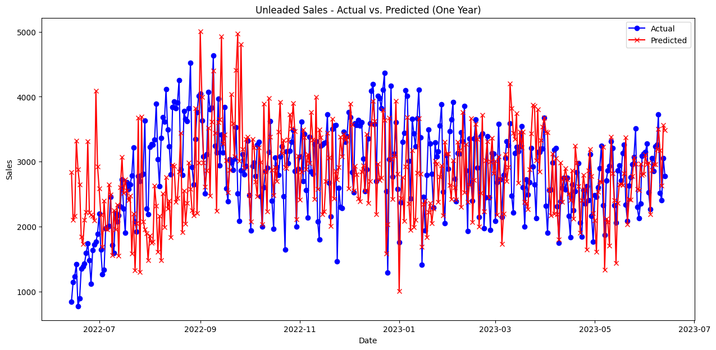
Model Performance: Actuals vs Predictions
Unleaded Sales Results
two_week - RMSE: 1228.1, MAPE: 95.3
three_week - RMSE: 1184.4, MAPE: 80.9
six_month - RMSE: 892.7, MAPE: 29.7
one_year - RMSE: 766.9, MAPE: 23.7

Slide 11
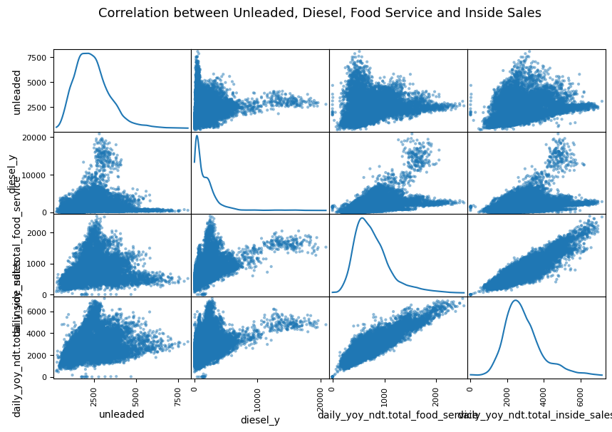
Additional Findings & Adjustments
Strong weekly seasonality
Holiday vs non-holiday
Low sales during store opening month
Features with no variability were dropped
Custom seasonalities were added
Store 21980 was removed due to unusually high diesel sales
Notes:
Generally, not much variability in holiday vs non-holiday Diesel experience very low sales on Thanksgiving, Christmas Eve, Christmas and New Years holidays
as an outlier due to exceptionally high diesel sales

Slide 12
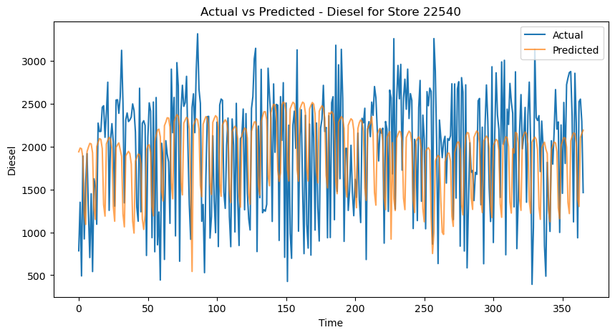
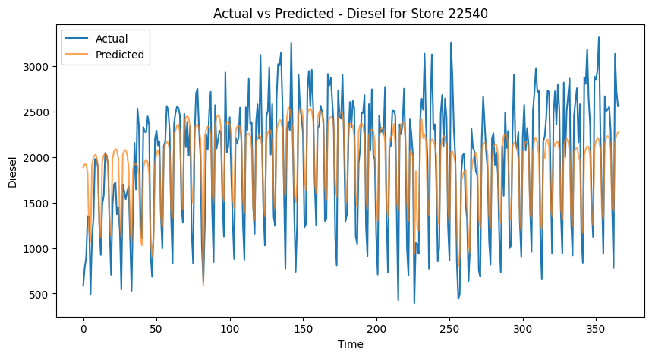
Adding National Diesel Prices
Before
After
RMSE: 822.41
MAE: 663.36
RMSE: 407.42
MAE: 326.50
Notes:
One of the predictors that greatly reduced our test store’s Diesel and Unleaded RMSE was including national Diesel and Unleaded prices.
While trend between Unleaded prices and Unleaded sales aren’t completely 1:1, we do see an increase in Unleaded sales at the same time that Unleaded prices increase which may explain the spike in residuals chart towards the end of the time series

Slide 13





Conclusion
Developed a rolling forecast model using Prophet
73% average error reduction using this model for store 24535
Seasonal strengths and adaptability
Included historical national Diesel and Unleaded prices and greatly reduced RMSE and MAPE
Computationally intensive process for one store
Notes:
We have developed a rolling forecast model using Prophet that produces daily sales predictions for a new store
Assuming an average benchmark score from the 37 stores, Maverik would have experienced an average 73% error reduction from using this model for store 24535
Applying our Prophet model with a rolling forecast has several advantages for time-series data, due to its seasonal strengths and adaptability to change in trend
Including historical national Diesel and Unleaded prices are very predictive and greatly reduce RMSE and MAPE
It is a computationally intensive model for one store. For all stores, it is important to use a computer with high CPU and RAM.

Slide 14
THANK YOU

Slide 15
Appendix

Slide 16
Prophet Model Rolling Forecast Overview
Prophet Model with Rolling Forecast
Initial Setup: Historical data is trained up to opening date
Daily Training: Four Prophet models created and updated daily for each sales metric
Daily Forecasts: Daily forecasts for the next 365 days.
Data Storage: Actuals and predictions are stored in dictionaries to produce performance metrics
Notes:
Developed by Facebook, Prophet is an open-source forecasting tool tailored for business time series data. It's designed to handle the common features of business forecasting, such as seasonality, holidays, and weekends.
It's particularly effective for datasets that have strong seasonal effects and several seasons of historical data.
Unlike more complex models, Prophet is easier to use and understand. It requires fewer manual interventions, making it ideal for our rolling forecast model.
Advantages
Robust to Shifts in Trend: Prophet can handle changes in trend, making it well-suited for real-world, fluctuating data. In the data provided, sales fluctuated due to various factors. Prophet's robustness makes it a useful tool for such scenarios.
Handles Seasonality with Ease: We leveraged Prophet's ability to model multiple seasonality patterns - day of week, seasons and yearly, which was crucial for predicting sales accurately.
Incorporates Special Events: Prophet allows the integration of special events. For Maverik, this meant incorporating the list of national holidays that significantly impact sales.
Our Model
Custom Seasonality and Holidays: We tailored the model to Maverik's specific business cycles, incorporating custom ‘season’ seasonal patterns, ‘day of the week’ and significant holidays patterns
Rolling Forecast: Our model is produced to update forecasts daily, incorporating the most recent sales data. This approach keeps the forecasts aligned with the latest trends and patterns.

Slide 17
Feature Selection
Features dropped
Front_door_count
Godfather_s_pizza
Diesel_x
Non_24_hour
Self_check_out
Car_wash
Ev_charging
Features included
National historical unleaded and diesel prices
Populations (x1_mile_pop, x1_2_mile_pop, x7_min_pop)
Number of RV & high-flow lanes, layouts, stack types
Men’s urinal count, women’s sink count
Serves pizza, cinnabon, etc
Store age
Store openings
Custom seasonalities
Seasons
Day of the week
Holidays
Store 21980
Removed as an outlier due to exceptionally high diesel sales
Notes:
Incorporating national unleaded and diesel prices into the model dropped RMSE/MAPE tremendously.

Slide 18
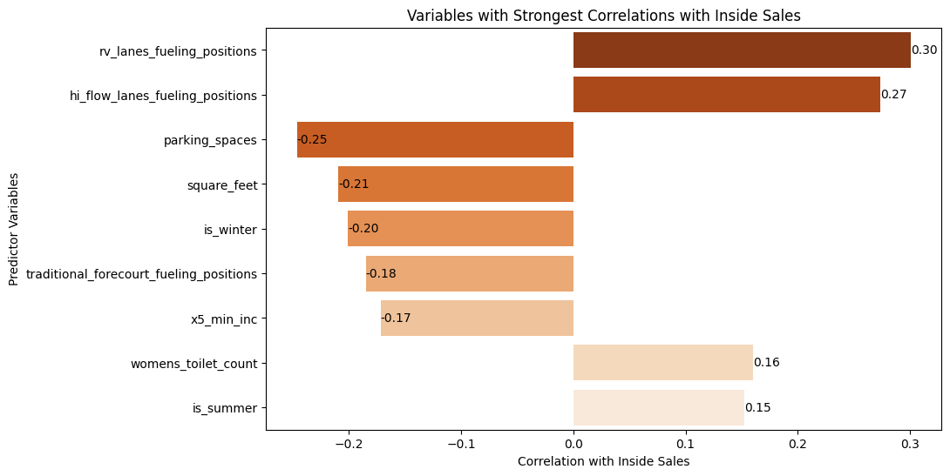
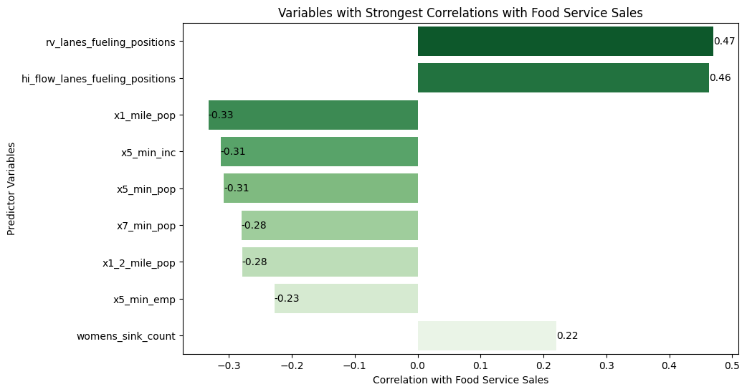
Correlations

Slide 19
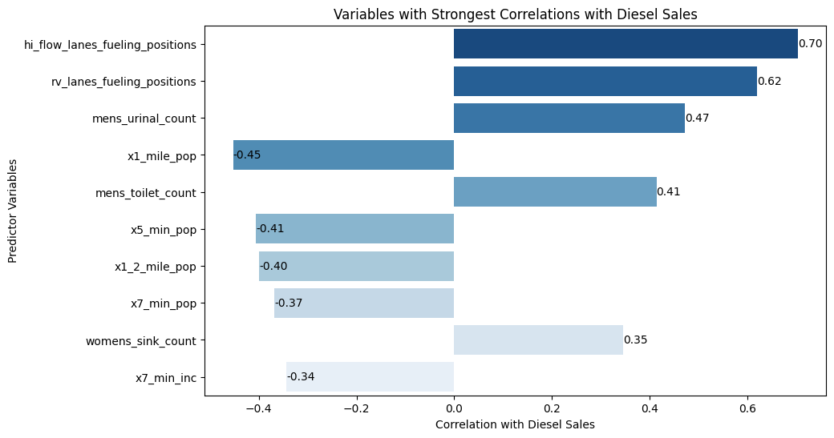
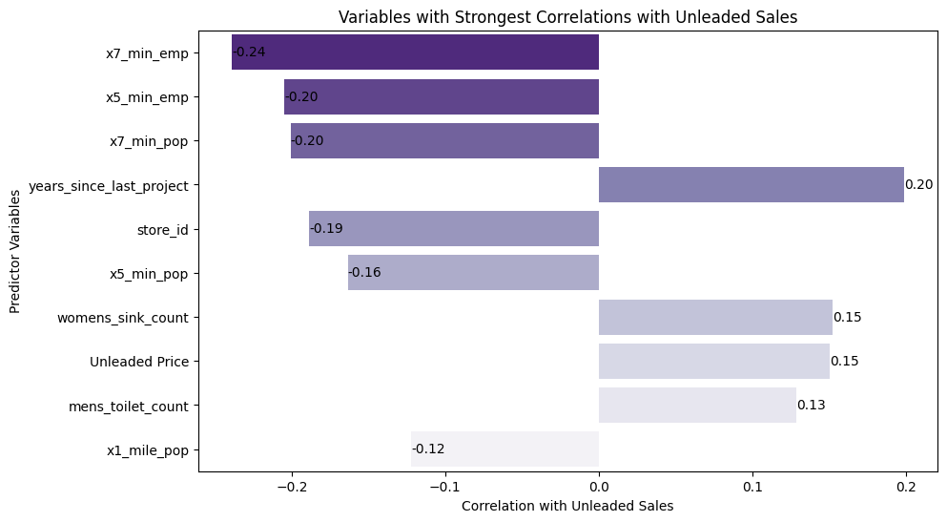
Correlations

Slide 20
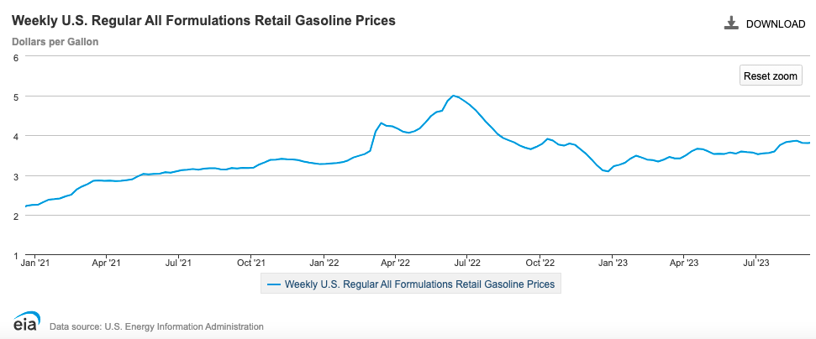
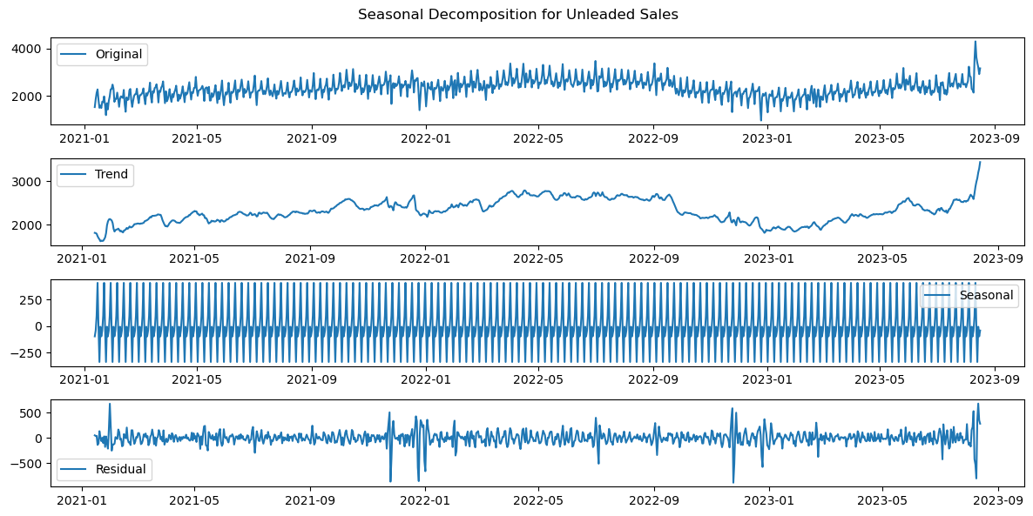
Seasonal Decomposition - Unleaded
Notes:
One of the predictors that greatly reduced our test store’s Diesel and Unleaded RMSE was including national Diesel and Unleaded prices.
While trend between Unleaded prices and Unleaded sales aren’t completely 1:1, we do see an increase in Unleaded sales at the same time that Unleaded prices increase which may explain the spike in residuals chart towards the end of the time series

